Slide 1
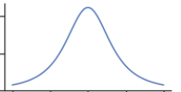
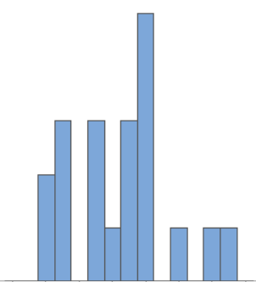
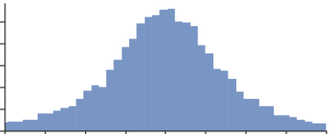
Bayesian Inference
Model Parameters
Observed Data
Model Equation
(Data Generating Process)
Prior
Distributions
Bayesian Inference
Posterior
Distributions

Slide 2
Bayesian Inference Documentation Roadmap
Section 2 Model Description
Section 1 Purpose & Background
Model Parameters
Observed Data
Model Equation
(Data Generating Process)
Prior
Distributions
Section 3 Results
Appendix A MCMC Diagnostics
Bayesian Inference
Posterior
Distributions

Slide 3
Appendix B Prior and Posterior Predictive Checks
Model Parameters
Simulated Data
Model
(Data Generating Process)
Prior
Distributions
Prior
Predictive
Model
(Data Generating Process)
Posterior
Predictive
Posterior
Distributions

Slide 4
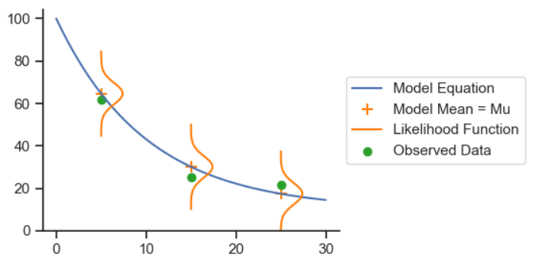
Likelihood Function

Slide 5
PFAS Precursor Model
Data Generating Processes
Observed Data
Model Parameters
TOP Assay Analyte Data
Precursors
TOP Assay Yield Matrix
[…]
Total PFOS Data
Sum of ECF Precursors

